Slide 1
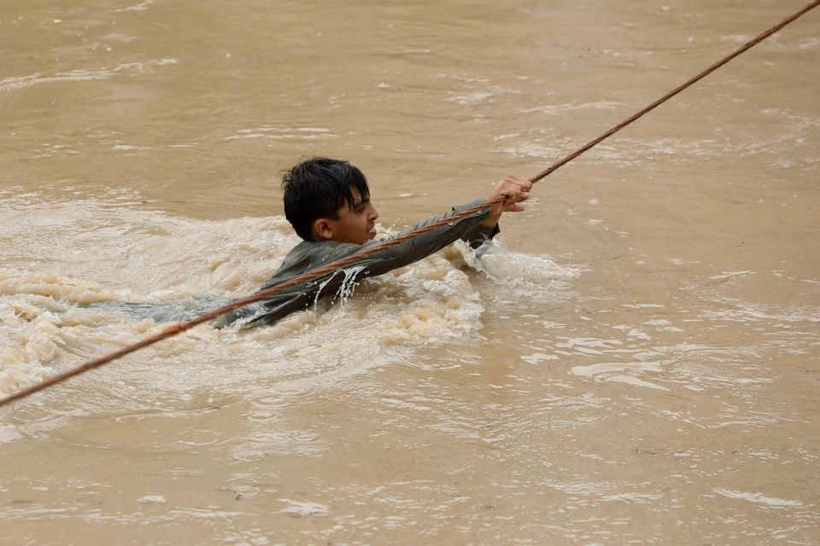
FLOODS
Allahdad

Slide 2
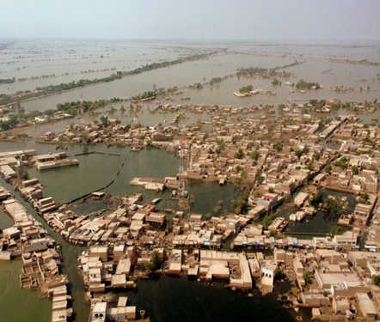
FLOOD
An overflow of water onto normally dry land. The inundation of a normally dry area caused by rising water in an existing waterway, such as a river, stream, or drainage ditch.

Slide 3
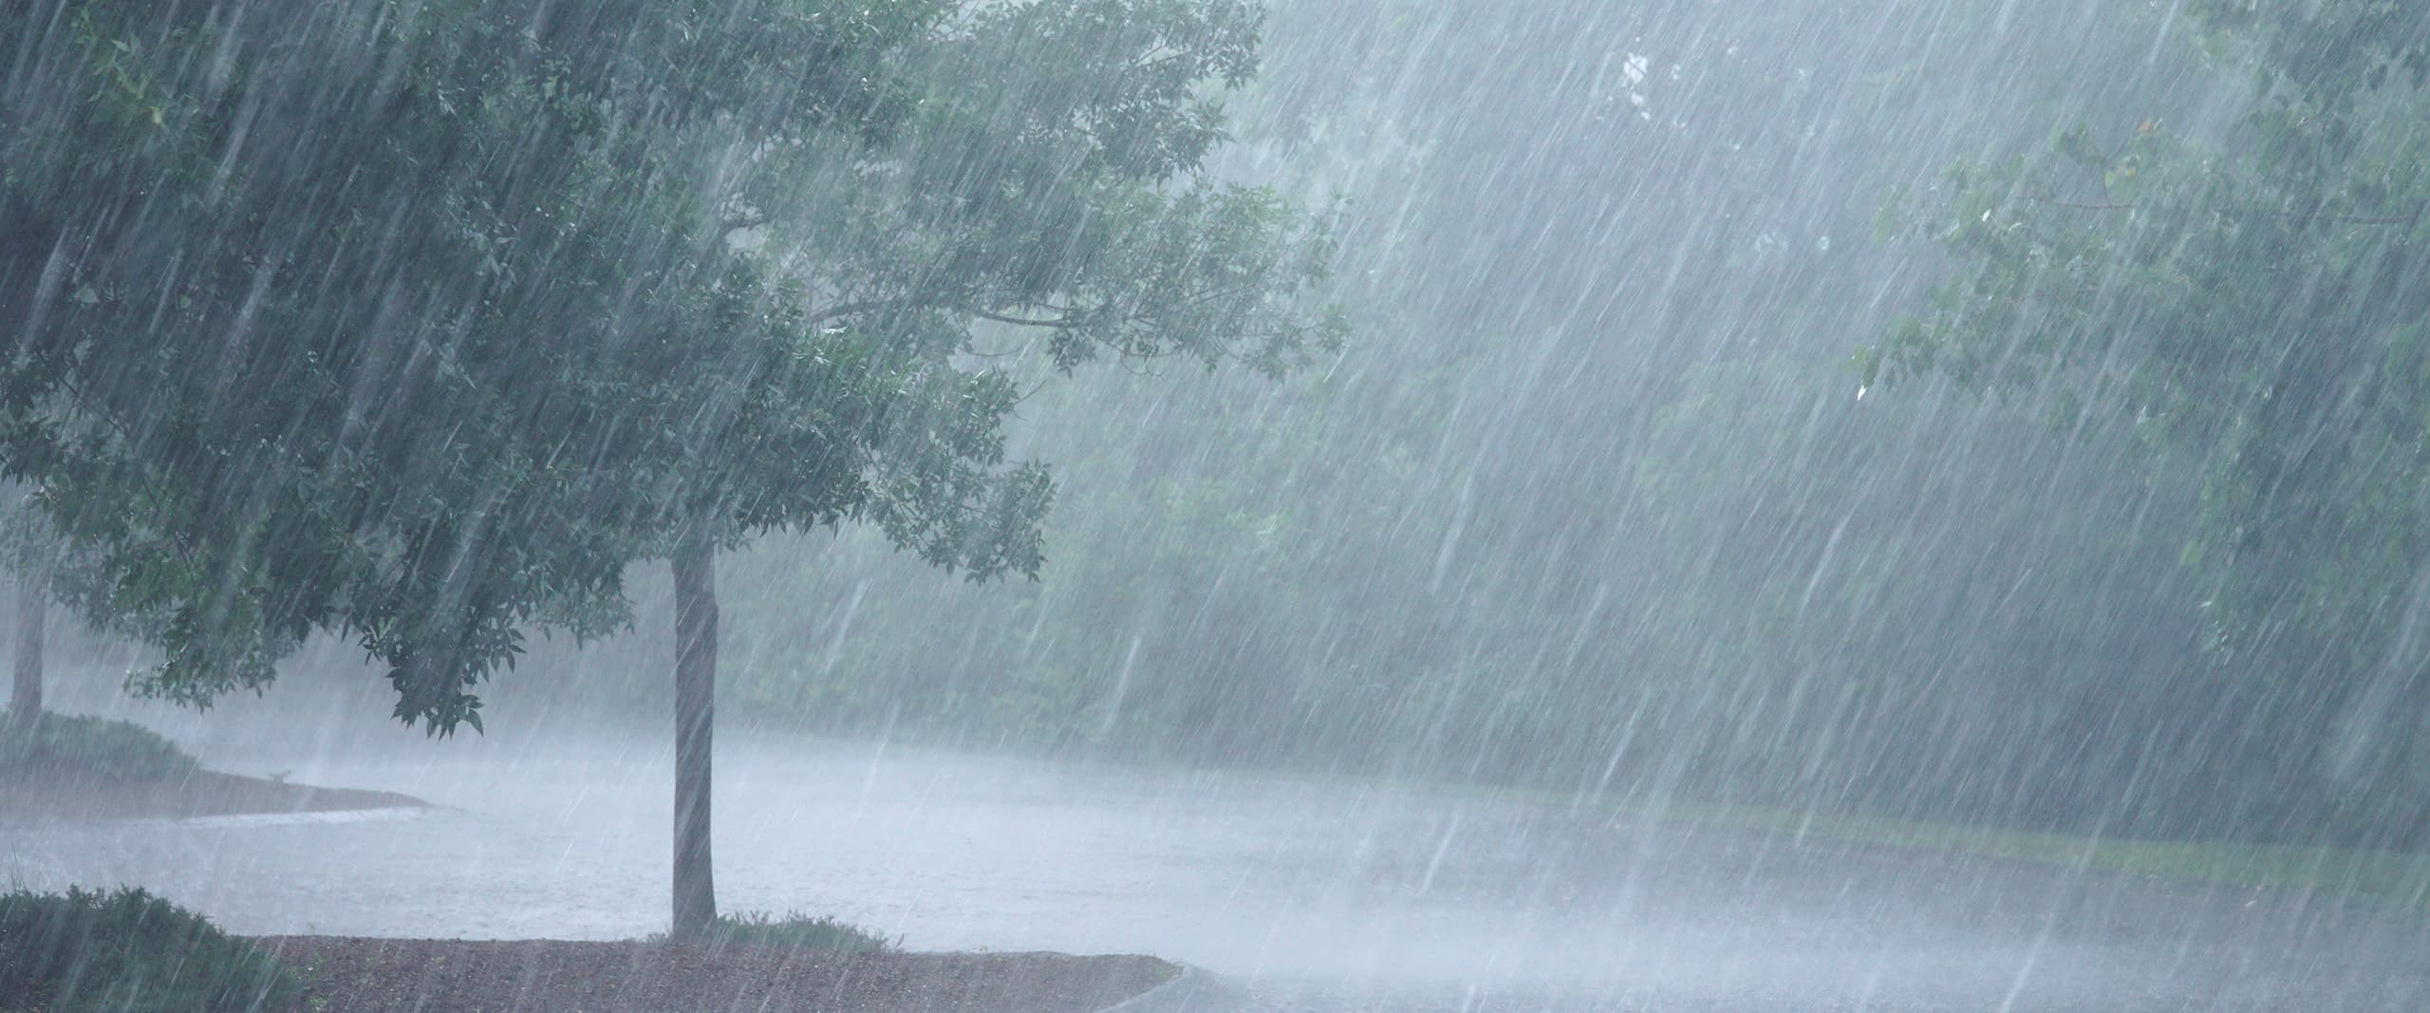
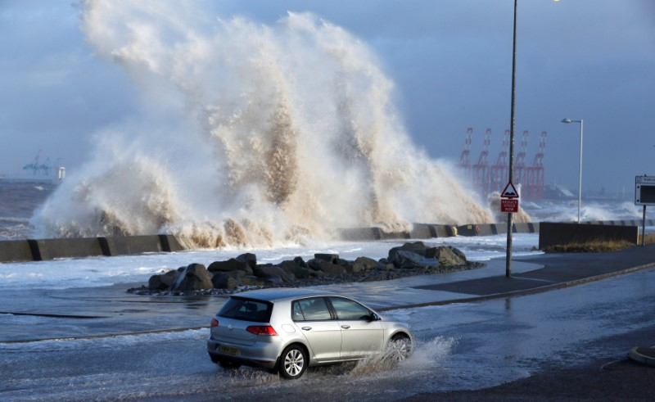
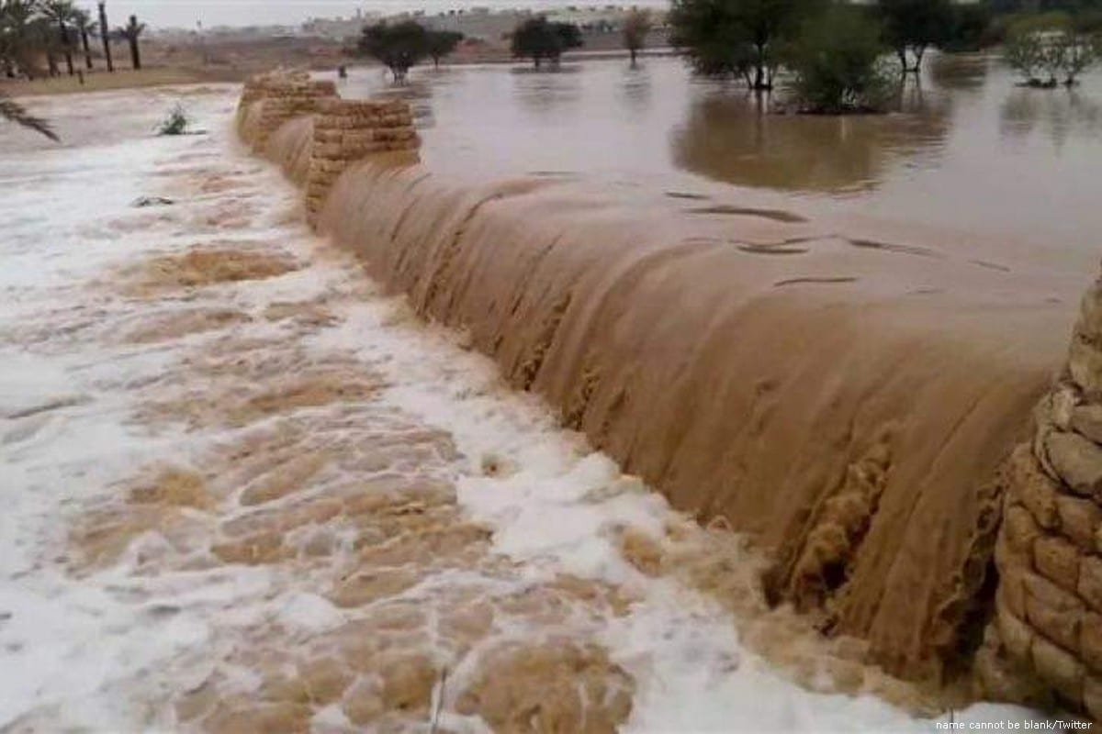
TYPES OF FLOOD
There are three types of flood:
Flash Flood
Coastal Flood
River Flood

Slide 4
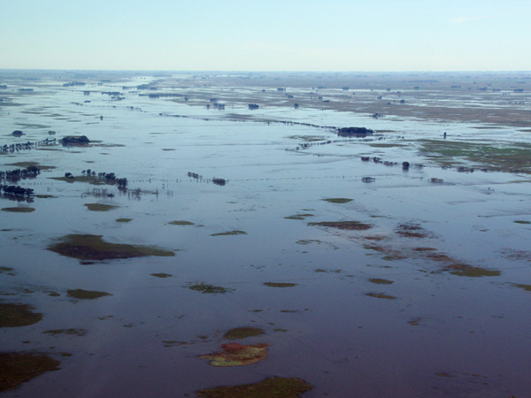
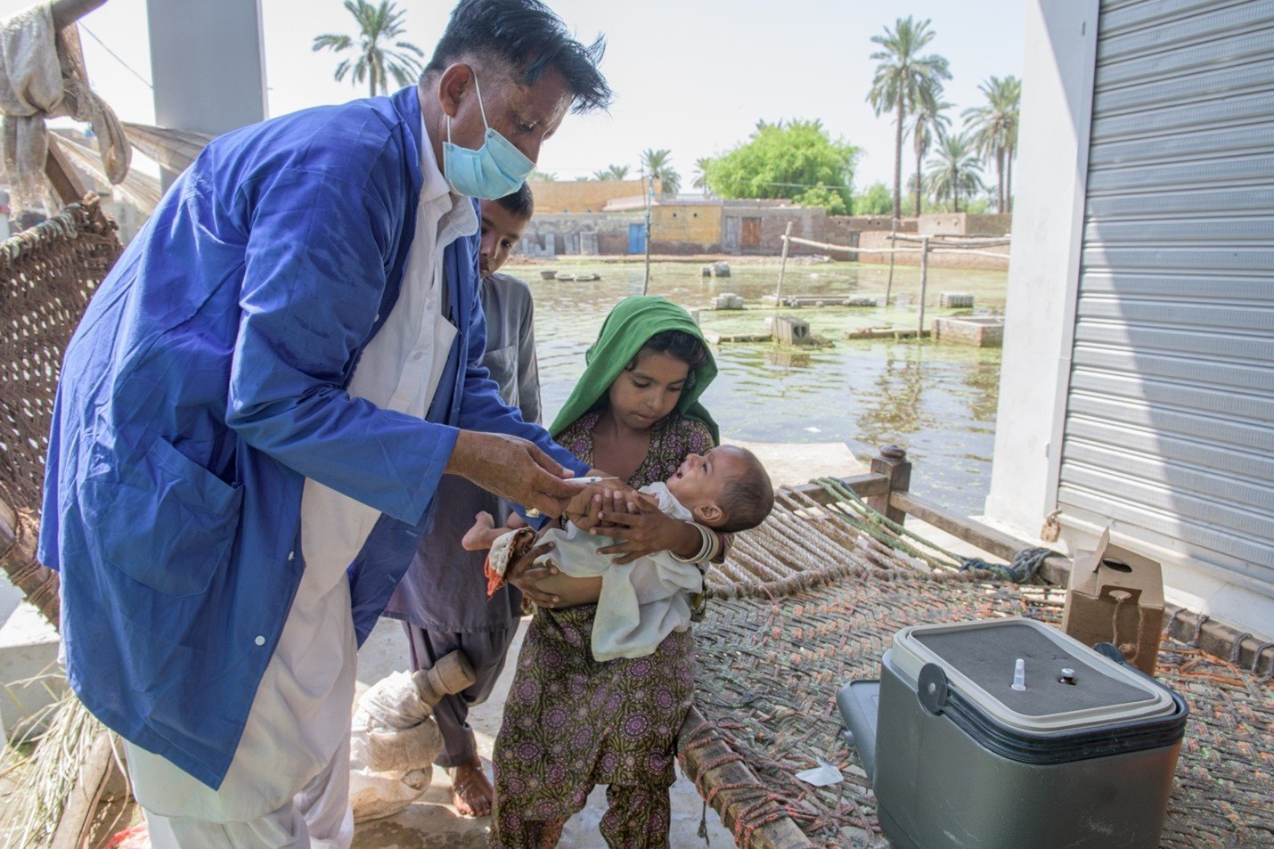
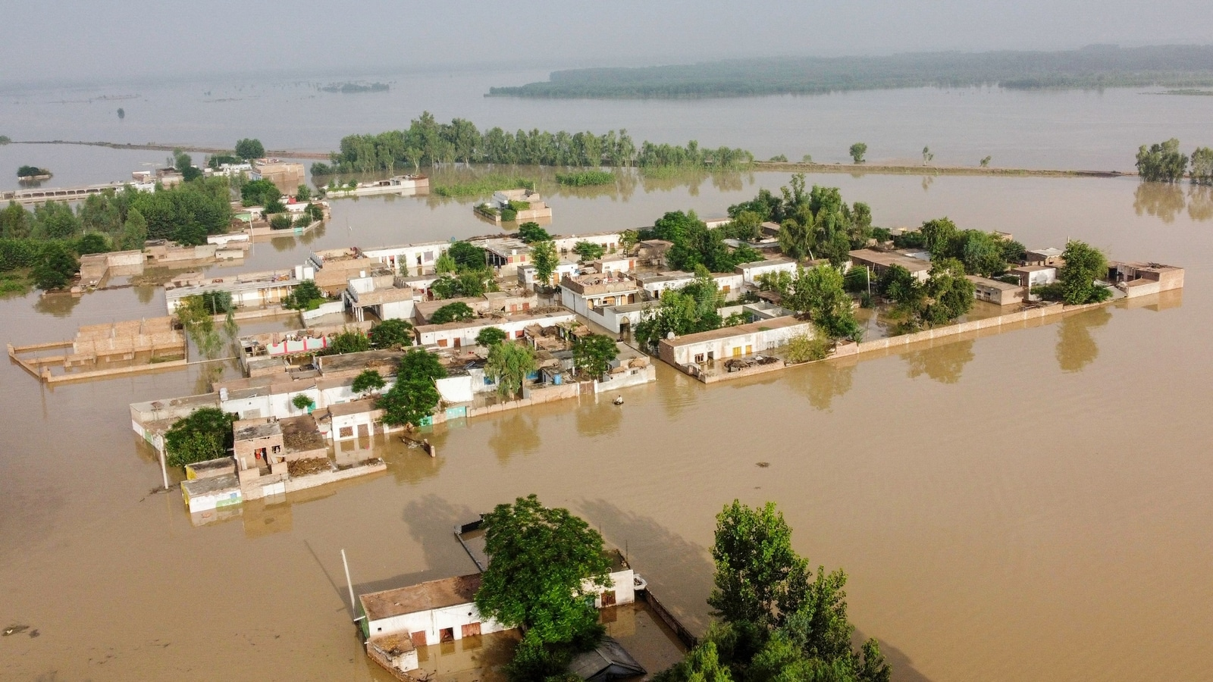
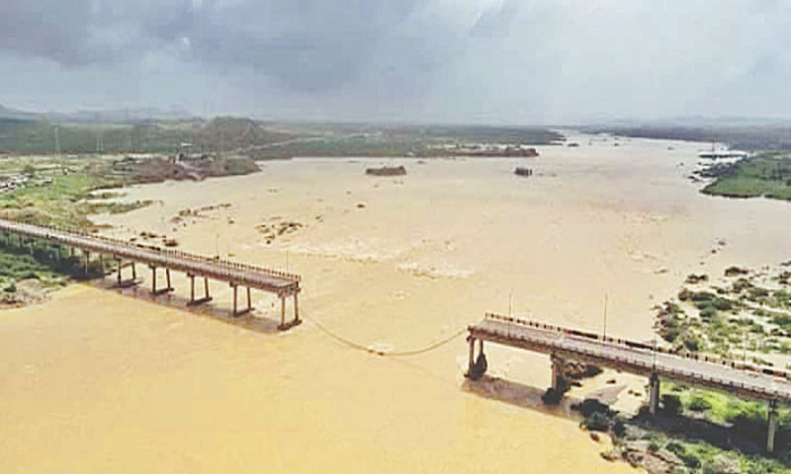
FLOOD DAMAGES
CROP DAMAGE
HEALTH DAMAGE
ROAD INFRASTRUCTURE
PROPERTY DAMAGE

Slide 5
CAUSES OF FLOOD
Many different situations can cause a flood. Here are just a few:
Heavy rainfall
Ocean waves coming on shore, such as a storm surge
Melting snow and ice, as well as ice jams
Dams or levees breaking

Slide 6
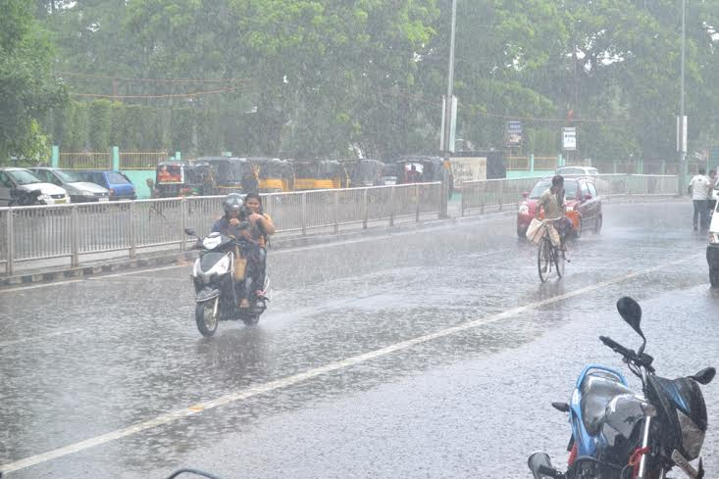
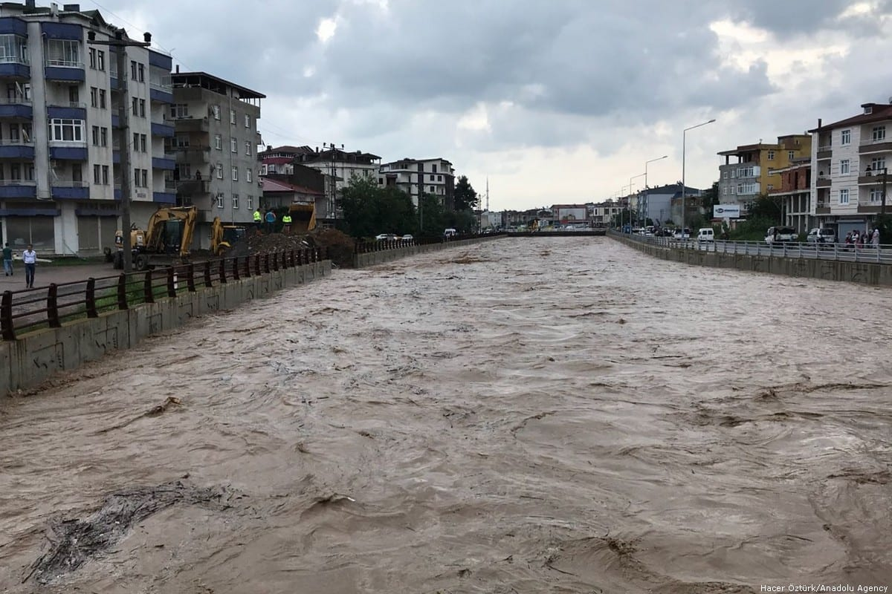
BILAWAL THEORY OF FLOOD
“ JAB BARISH AATA HAI TOH PAANI AATA HAI ,
JAB ZYADA BARISH AATA HAI TOH ZAYADA PANI AATA HAI “
“JAB ZYADA BARISH AATA HAI TOH ZAYADA PANI AATA HAI”
This is called flood

Slide 7
FLOODS IN PAKISTAN
Pakistan has faced many floods from past 73 years and faced huge difficulties due to these disasters. The high floods occurred during 1942, 1956, 1957, 1958, 1973, 1975, 1976, 1979, 1992, 1994, 1995, 2003, 2005 , 2007,2010 and 2022.
I am going to share information about Huge floods that caused most damage to Pakistan.
List of huge floods :
Flood in 2003
Flood in 2007
Flood in 2010
Flood in 2011
Flood in 2022

Slide 8
FLOOD IN 2003
In 2003, Sindh province was badly affected when above normal monsoon rainfall caused flooding in the province; urban flooding also hit Karachi where two days of rainfall of 284.5 millimeters (11.20 in) created havoc in the city.
while Thatta District was the worst hit where 404 millimeters (15.9 in) rainfall caused flash floods in the district. At least 484 people were killed and some 4,476 villages in the province were affected.

Slide 9
FLOOD IN 2007
In 2007, Khyber Pakhtunkhwa, Sindh and coastal Balochistan were badly affected due to monsoon rainfall.
Sindh and coastal Balochistan were affected by Cyclone Yemyin in June and then torrential rains in July and August, while Khyber Pakhtunkhwa was affected by melting glaciers and heavy rainfall in July and August. At least 130 people died and 2,000 were displaced in Khyber Pakhtunkhwa in July and 22 people died in August, while 815 people died in Balochistan and Sindh due to flash floods.

Slide 10
FLOOD IN 2010
In 2010, almost all of Pakistan was affected when massive flooding, caused by record breaking rains, hit Khyber Pakhtunkhwa and Punjab. The number of people affected by the flooding exceeds the combined total affected by the 2004 Indian Ocean earthquake and tsunami, the 2005 Kashmir earthquake and the 2010 Haiti earthquake.[ At least 2,000 people died in the flood and almost 20 million people were affected by it.

Slide 11
FLOOD IN 2011
In September 2011, at least 361 people were killed, some 5.3 million people and 1.2 million homes affected as well 1.7 million acres of arable land inundated when massive floods swept across the province of Sindh as a result of monsoon rains.

Slide 12
FLOOD IN 2020
In August 2020, Karachi received the heaviest rain in a single day ever in its history when 231 mm rain lashed out in just 12 hours. During August 2020, only Karachi received 484 mm (19 inches) rain. It is the highest rainfall record over the last 90 years. Rainwater and overflowed water from nullahs and drains flooded most of the main roads and streets in residential locations, a significant number of residential areas including urban slums and villages in peri-urban areas, that gravely disrupted the people’s lives.

Slide 13
FLOOD IN 2022
From June to August 2022, flooding affected most of Pakistan. The provinces of Balochistan and Sindh were worst hit, while floods had also affected other parts of the country as far north as Kashmir. At least 1,500 people died in the flooding with 16 million children affected.

Slide 14
HOW TO CONTROL FLOOD ?
Some methods of flood control have been practiced since ancient times.¹ These methods include planting vegetation to retain extra water, terracing hillsides to slow flow downhill, and the construction of floodways (man-made channels to divert floodwater).¹ Other techniques include the construction of levees, dikes, dams, reservoirs¹ or retention ponds to hold extra water during times of flooding.

